Slide 1

CSE488: Big Data Analytics
Lecture 5: Spark – Extending MapReduce
Dr. Mohammad Rezwanul Huq
Associate Professor
East West University

Slide 2
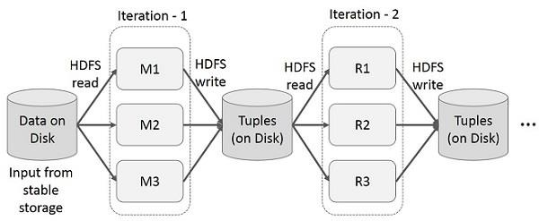
MapReduce:
  Incurs substantial overheads due to data replication, disk I/O, and serialization

Slide 3
Two major limitations of MapReduce:
  Difficulty of programming directly in MapReduce
    Many problems aren’t easily described as map-reduce
  Performance bottlenecks, or batch not fitting the use cases
    Persistence to disk typically slower than in-memory work
In short, MapReduce doesn’t compose well for large applications
  Many times, one needs to chain multiple map- reduce steps.

Slide 4

MapReduce uses two “ranks” of tasks:
One for Map the second for Reduce
  Data flows from the first rank to the second
Data-Flow Systems generalize this in two ways:
Allow any number of tasks/ranks
Allow functions other than Map and Reduce
As long as data flow is in one direction only, we can have the blocking property and allow recovery of tasks rather than whole jobs

Slide 5
Expressive computing system, not limited to the map-reduce model
Additions to MapReduce model:
  Fast data sharing
    Avoids saving intermediate results to disk
    Caches data for repetitive queries (e.g. for machine learning)
  General execution graphs (DAGs)
  Richer functions than just map and reduce
Compatible with Hadoop

Slide 6
Spark: History
Apache Spark is an open-source data processing engine to store and process data in real-time across various clusters of computers using simple programming constructs
2009: Started as a project at UC Berkley AMPLab
2010: Open sourced under a BSD license
2013: Spark became an Apache top level project
2014: Used by Databricks to sort large-scale datasets and set a new world record

Slide 7

One of the most in-demand technology and processing framework in big data world
Open source software (Apache Foundation)
Supports Java, Scala and Python
Key construct/idea: Resilient Distributed Dataset (RDD)
Higher-level APIs: DataFrames & DataSets
  Introduced in more recent versions of Spark
  Different APIs for aggregate data, which allowed to introduce SQL support

Slide 8
Spark: Features
Fast Processing
In-memory computing
Flexible
Fault tolerance
Better analytics

Slide 9

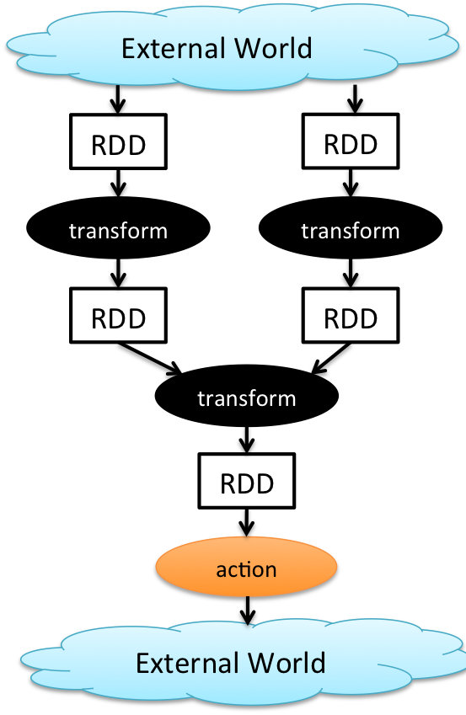
Key concept Resilient Distributed Dataset (RDD)
Immutable, fault tolerant, partitioned/distributed collection of records
  val x = sc.textfile(“…….”) 🡪 RDD
Spread across the cluster, Read-only
Caching dataset in memory
  Fallback to disk possible
RDDs can be created from Hadoop, or by transforming other RDDs (you can stack RDDs)
RDDs are best suited for applications that apply the same operation to all elements of a dataset

Slide 10

Transformations build RDDs through deterministic operations on other RDDs:
  Transformations include map, filter, join, union, intersection, distinct
  Lazy evaluation: Nothing computed until an action requires it
Actions to return value or export data
  Actions include count, collect, reduce, save
  Actions can be applied to RDDs; actions force calculations and return values

Slide 11
DataFrame:
  Unlike an RDD, data organized into named columns, e.g. a table in a relational database.
  Imposes a structure onto a distributed collection of data, allowing higher-level abstraction
Dataset:
  Extension of DataFrame API which provides type- safe, object-oriented programming interface (compile-time error detection)
Both built on Spark SQL engine. Both can be converted back to an RDD.

Slide 12
Spark SQL
Spark Streaming – stream processing of live datastreams
MLlib – scalable machine learning
GraphX – graph manipulation
  Extends Spark RDD with Graph abstraction: a directed multigraph with properties attached to each vertex and edge

Slide 13
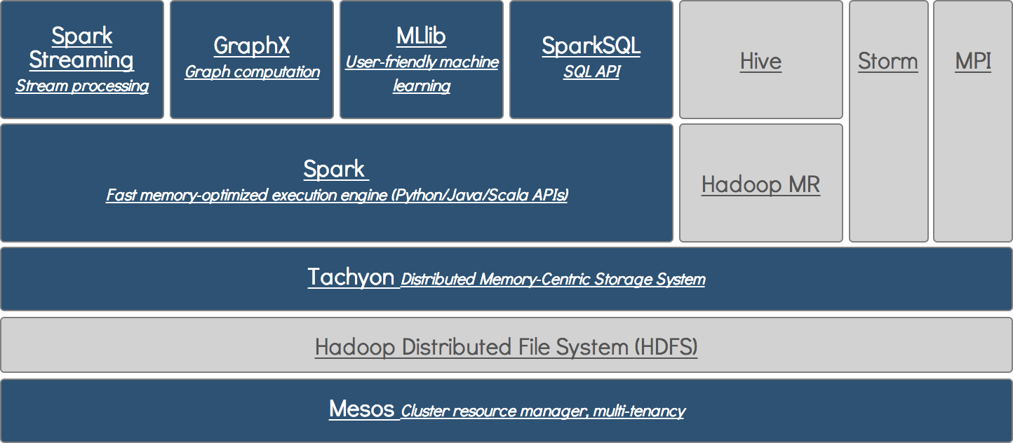

Slide 14
Performance: Spark normally faster but with caveats
  Spark can process data in-memory; Hadoop MapReduce persists back to the disk after a map or reduce action
  Spark generally outperforms MapReduce, but it often needs lots of memory to perform well; if there are other resource-demanding services or can’t fit in memory, Spark degrades
  MapReduce easily runs alongside other services with minor performance differences, & works well with the 1-pass jobs it was designed for
Ease of use: Spark is easier to program (higher-level APIs)
Data processing: Spark more general

